Slide 1
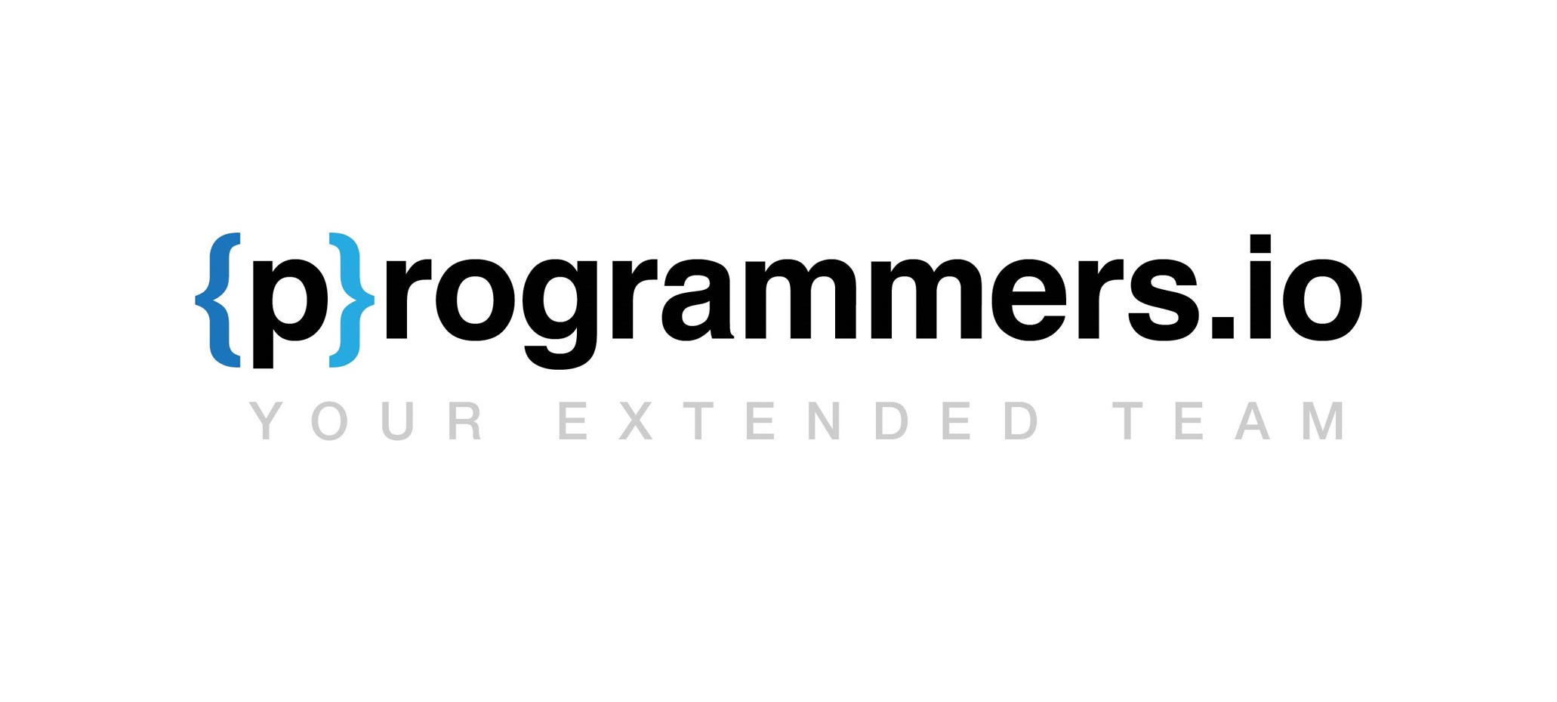
A Modern Approach to take the Development on IBMi to the next level
DevOps on IBMi

Slide 2


Topics covered
The what and why of DevOps?
Integral Parts of DevOps
Git it done!
Local vs Cloud Git?
Project Management
Pipeline
Conclusion
Programmers.io Confidential and Proprietary

Slide 3

What is DevOps?
DevOps is a set of practices that provides integration between software development (Dev) and IT operations (Ops).
Improve the speed and quality of agile software development.
Easy collaboration with cross platform teams.
Automation is the core of DevOps.
Why is it required?
Future proof your existing Tech Stack.
Easier to find younger talent.
DevOps is the IBMi Modernization that we all needed.
Programmers.io Confidential and Proprietary

Slide 4
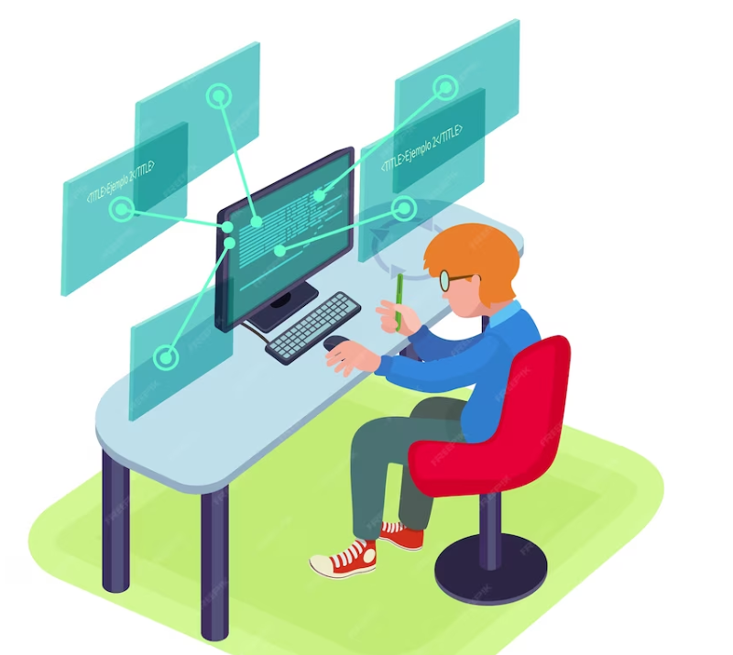
Integral Parts of DevOps
Source Control Management / Version Control System
E.g., GIT, SVN
CI/CD Pipeline
E.g., Jenkins, GitLab CI/CD
Project Management
JIRA, GitHub, Azure DevOps
Modern IDE
VS Code, RDi
Programmers.io Confidential and Proprietary

Slide 5
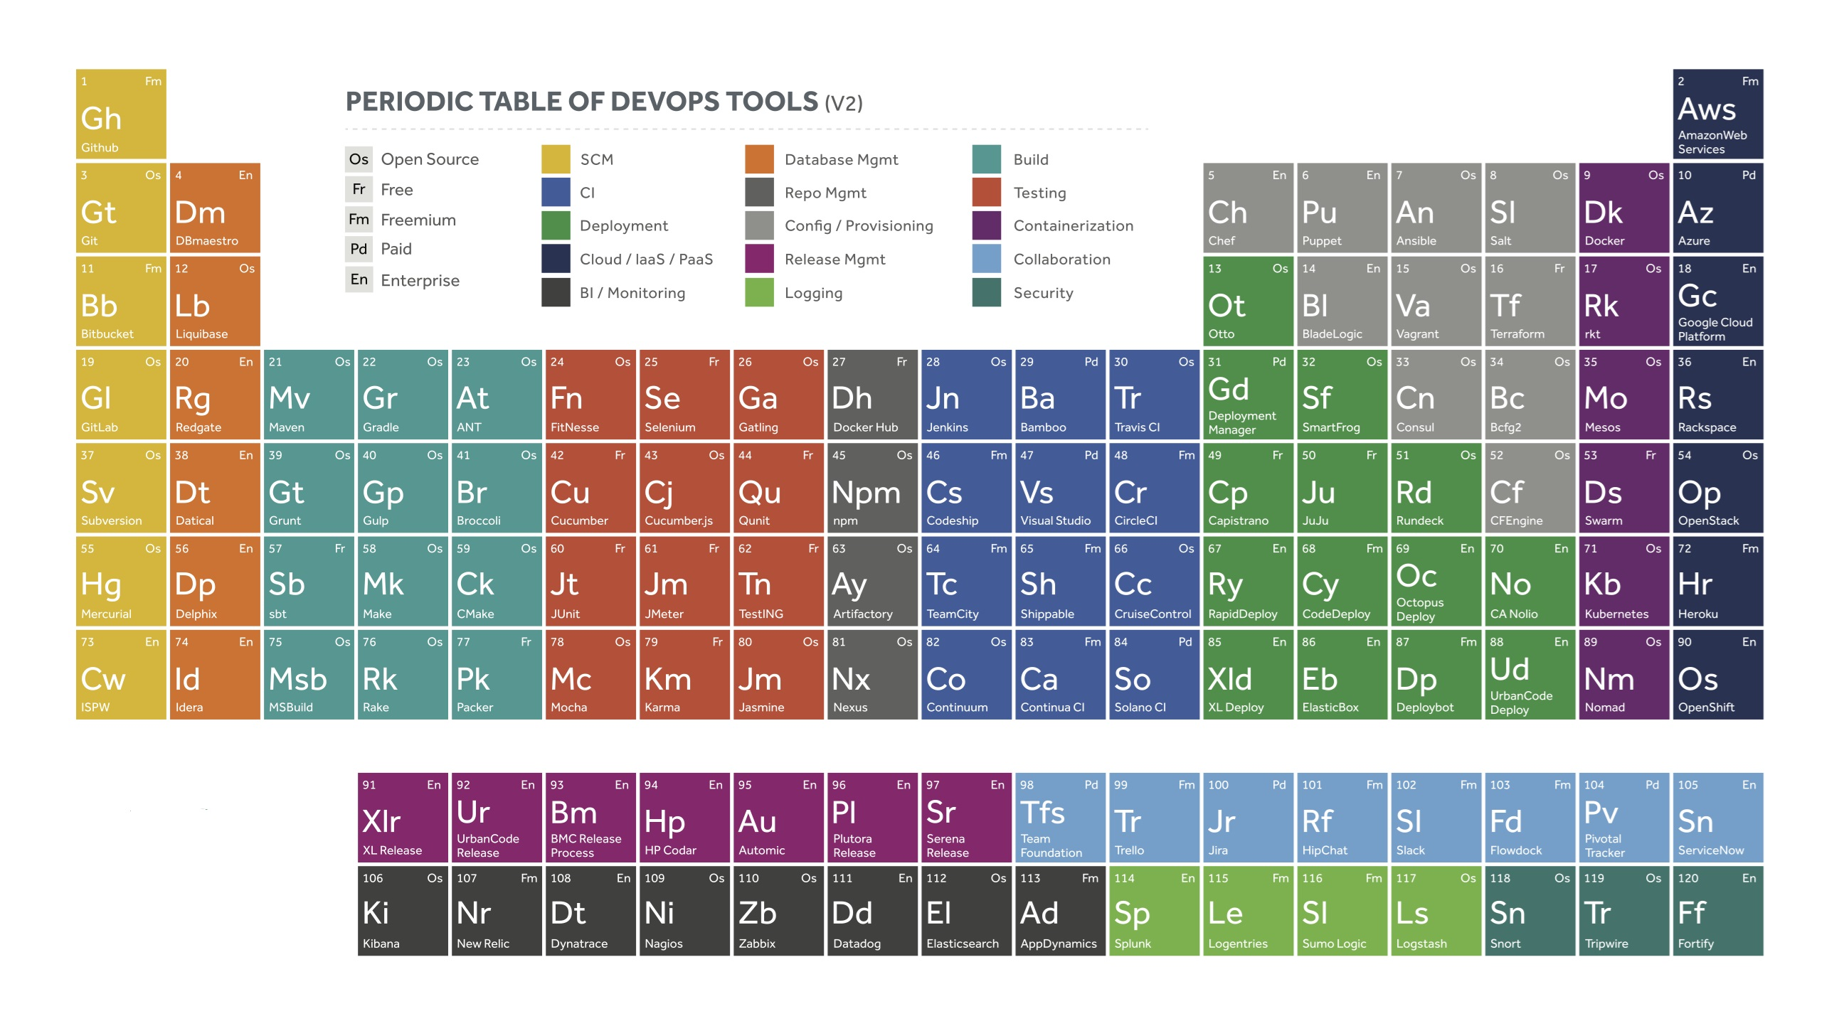
Wait, is that all we got?
Programmers.io Confidential and Proprietary

Slide 6
GIT-ting ahead in Development
Let’s talk about GIT:
It is the big daddy of Version Control System. Like any other VCS, it is used to keep track of changes to your source code.
But, wait…
We have Turnover, Implementor, Aldon , etc., already!
GIT
is 100% free and open source
is a distributed VCS
empowers parallel development
enables historical comparison
is snapshot based.
enables local operations.
enables powerful integration
Programmers.io Confidential and Proprietary

Slide 7
GitHub – A GIT with Wings!
GitHub:
World’s largest Source Code Hosting Platform.
Has Project Management Tool built in.
It helps to create excellent documentation.
Collaboration and real-time updates
Project Boards
Third Party Integration
Programmers.io Confidential and Proprietary

Slide 8
Questions and Answers?

